Slide 1




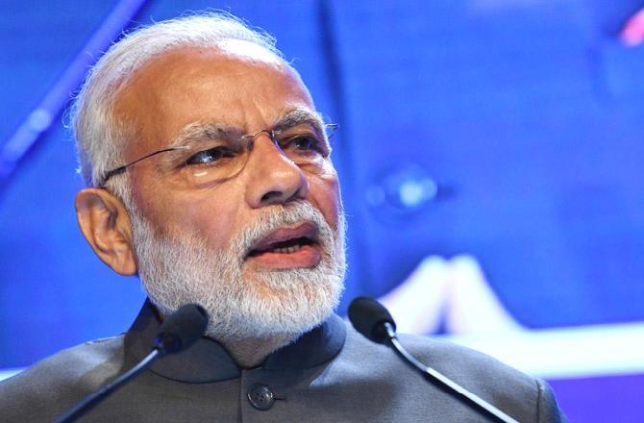
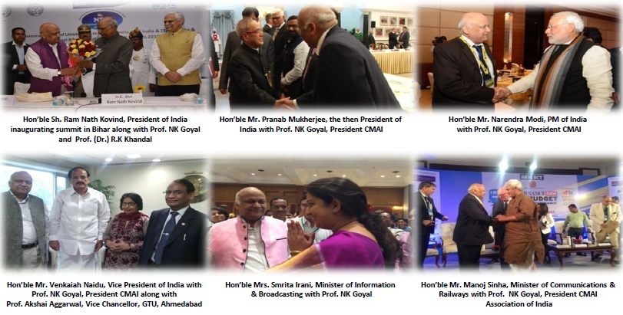
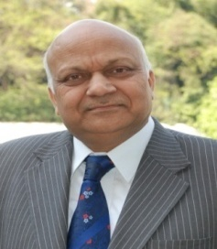
National Data Centre & Cloud Empowerment
Development Council
We are in an age of a historic transition brought about by technology.
Data Analytics and Artificial Intelligence are helping us build a whole range of value added services for people.
Hon’ble Dr. Narendra Modi, Prime Minister, India
The new Council we are establishing will provide a much needed industry body to represent the interests of its members, offer a forum to monitor regulatory developments, and to promote the industry within India and internationally.
National Data Centre & Cloud Empowerment Development Council is India’s premier, non-political, not-for-profit body representing Indian Data Sector. NDCED endeavor is to promote, promulgate and popularize the concept of Data Centre as a mode of doing business across the globe into several verticals. National Data Centre & Cloud Empowerment Development Council catalyses change by working closely with stakeholders and policymakers on policy issues, enhancing efficiency, competitiveness and expanding business opportunities for Data sector through a range of specialized services and global linkages. Council also provides a platform for Data sector consensus building and networking, partnership with counterpart chambers across the world carry forward our initiatives of inclusive development in Data & Cloud business, which encompasses entrepreneurship, training, governance, skill development, etc. Council will serve as the first opportunity of call for Indian Data Centre working for Globe.
National Data Centre & Cloud Empowerment Development Council
Organizes world class networking Data & Cloud events, conferences and expos
Promotion of Data Center & Cloud
Association with Indian and International Organizations
Proactive dialogues with Government bodies
Promotion of Data & Cloud Center company brand in India and Abroad
Taking delegations Abroad
Dedicated magazine for Data Centre in Globe
“Cloud and Data Centers in India are entering a
new phase & offers biggest market opportunities,
as these critical services support the digital
transformation of enterprises across the country,”
Professor NK Goyal, President , CMAI Association
Prof. NK Goyal, President, CMAI Association of India & Chairman Emeritus, TEMA
For Membership please Contact :-Navtesh , ED , navtesh@cmai.asia , 011 26266211/411/412,
+91 9711 869 771 , www.cmai.asia www.nationaleducationaward.com

Slide 2
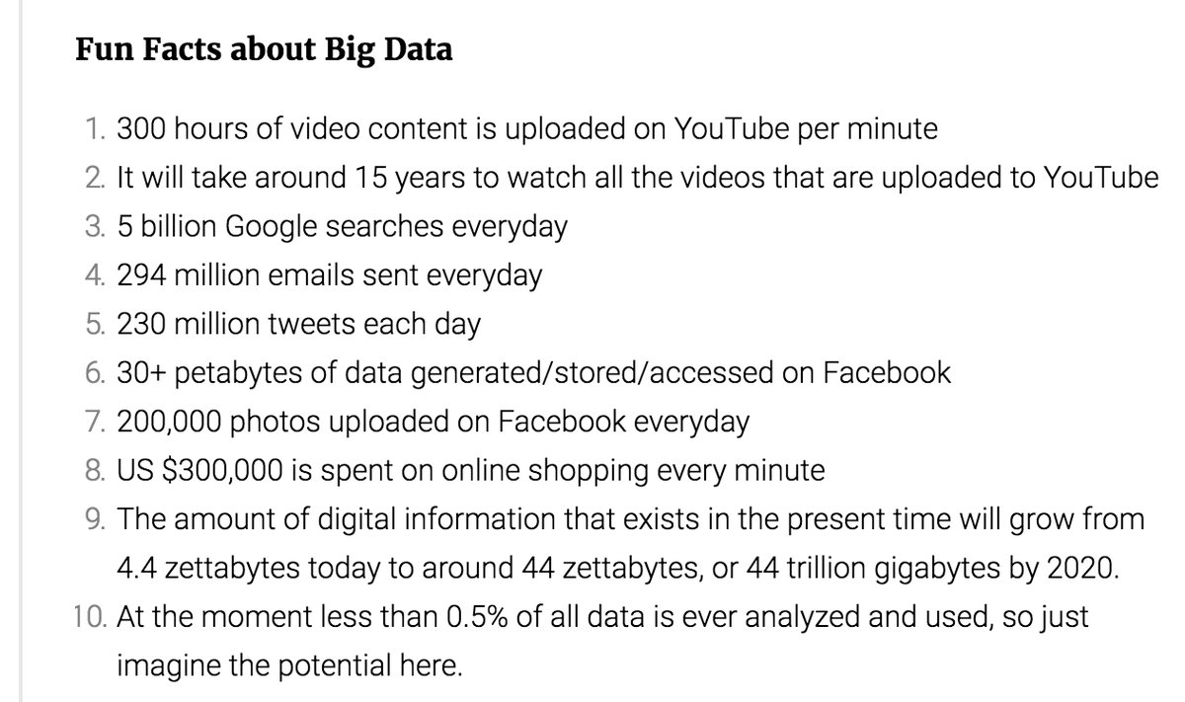
National Data Centre Empowerment
& Development Council
Membership The membership is now open. We request you to kindly give our consent to join by simply giving following information & send at navteshgoyal@yahoo.com & president_cmai@cmai.asia
Name of company
Manufacturer / Trader / Consultant
Name of Brand
Name of MD/CEO with email and mobile number
Name of contact person with email & mobile number
Products & Areas of Interest
Any other inf.
CMAI (www.cmai.asia)
CMAI Association of India is the largest ICT Association with 48,500 members and 54 MOU partners worldwide. CMAI is broad based including mobile, telecom, equipments, IT, infrastructure, Multimedia, Infrastructure, SME’s, Radiation, E-Waste, Aviation, Education etc. CMAI is actively engaged for strategic co ordination between Education Institutes and Industry for employability and curriculum up gradation. CMAI is represented on the board of several educational institutes. CMAI was made chairman of the vocational educational qualification framework committee for ICT by MOHRD along with AICTE and co-coordinator for other sectors. CMAI is also actively engaged in skill development and vocational programs for Educational Institutes.
CMAI Board consists of Patrons & Chairman of Expert Councils- Shri Shayamal Ghosh, (IAS:1964), Shri MK Kaw(IAS:1964), Shri Vinod Vaish (IAS:1966) Ex Secy DOT; Shri Harsh Gupta (IAS:1966) Ex Chief Secretary, HP; Shri Dhanendra Kumar (IAS:1968) Ex Chairman Competition Commission of India and Directors Mr. Moosa Raja (IAS;1960), IAS; Mr BB Tandon, (IAS: 1965) Ex Chief Election Commissioner; Mrs Suneeta Mukherjee, (IAS: 1972) Ex Advisor UNIDO and several other Bureaucrat & industry professionals and telecom experts.
TEMA (www.tematelecom.in)
Established on 1st June, 1990, Telecom Equipment Manufacturers Association of India (TEMA) is considered by the Government of India as the National Apex body to represent telecom Technology Providers, Global and Indian, Private and Government owned companies. Being the official mouthpiece of Indian telecom manufacturing industry, TEMA plays the critical role of advising the government and influencing decisions relating to Indian telecom industry.
TEMA also enjoys the privilege of proposing names of technical experts from the industry to various telecom committees of the Government of India and major national industry associations.
TEPC (www.telecomepc.in)
TEMA has been in forefront for formation of TEPC. When initially announced, it was named by Ministry of Commerce and Industries as TEMA Export Promotion Forum. With expansion of activities to manufacturing and services sector, now named as Telecom Equipment and Services Export Promotion Council (TEPC) .
TEPC has been set up by the Ministry of Commerce & Industry and Ministry of Communications & IT, Government of India to promote and develop of Export of Telecom Equipments and Services. TEPC undertakes several activities aimed at export promotion such as Commissioning of Studies to find potential markets, holding of National/International Seminars and facilitating participation of exporters in various overseas exhibitions.

